Slide 1
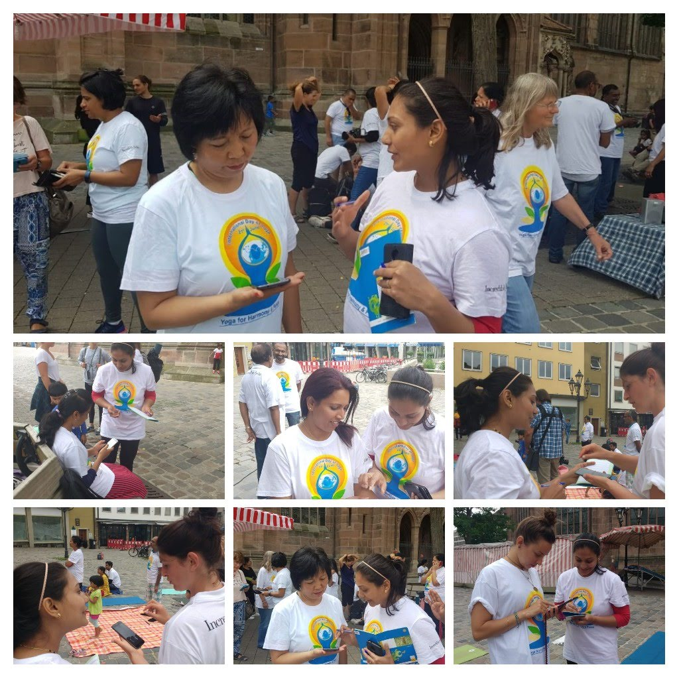
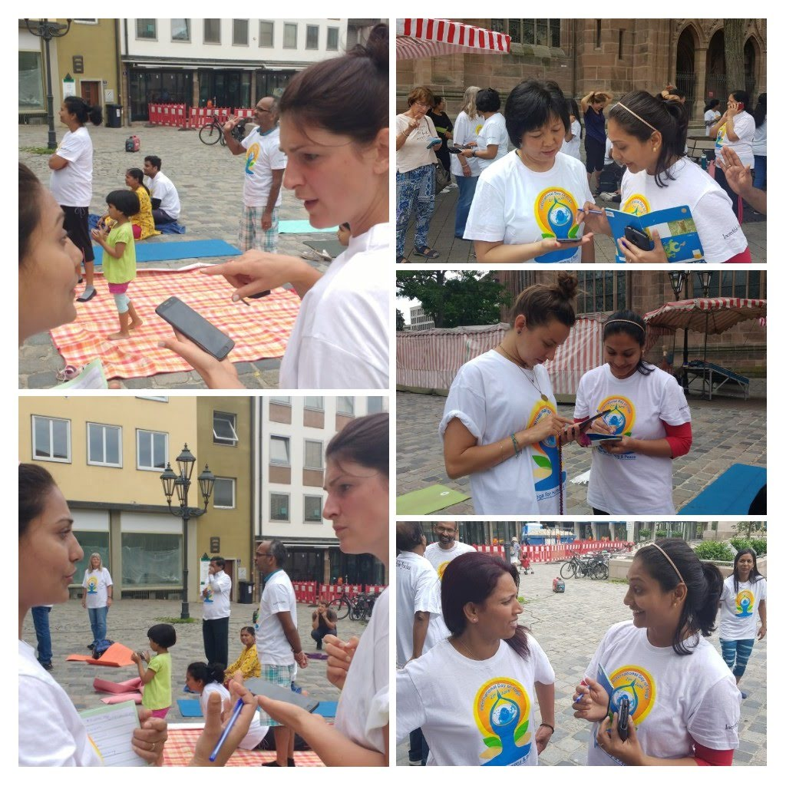
4.5: Conducting Usability Tests
Minal Bombatkar

Slide 2
Methodology
All tests were conducted moderated between the 20 June -22 of June. More than 4 participants were tested (using Hallway Testing method) in-person in Nuremberg, Germany on the occasion of International Yoga day, so that it is easy to reach out to the target audience for my Yogic app.
The prototype was tested on my own Android mobile.
The other one participant was in India and remotely tested. For conducting and recording tests remotely I used Skype, which also worked really well. I also took notes with pen and paper.

Slide 3
Thoughts
Before testing, I explained the mechanics of yogic app prototypes, so participants knew how to interact.
People were curious and seemed to complete the task easily. The testing was fun, finding 6 participants wasn‘t easy though. I took the advantage of “International yoga day” celebration event and reach out to the exactly yoga followers.
Each participant had their very own thoughts about the prototype. And some participants ask me when this app will available in App store, they are super excited to see this type of app in live.

Slide 4
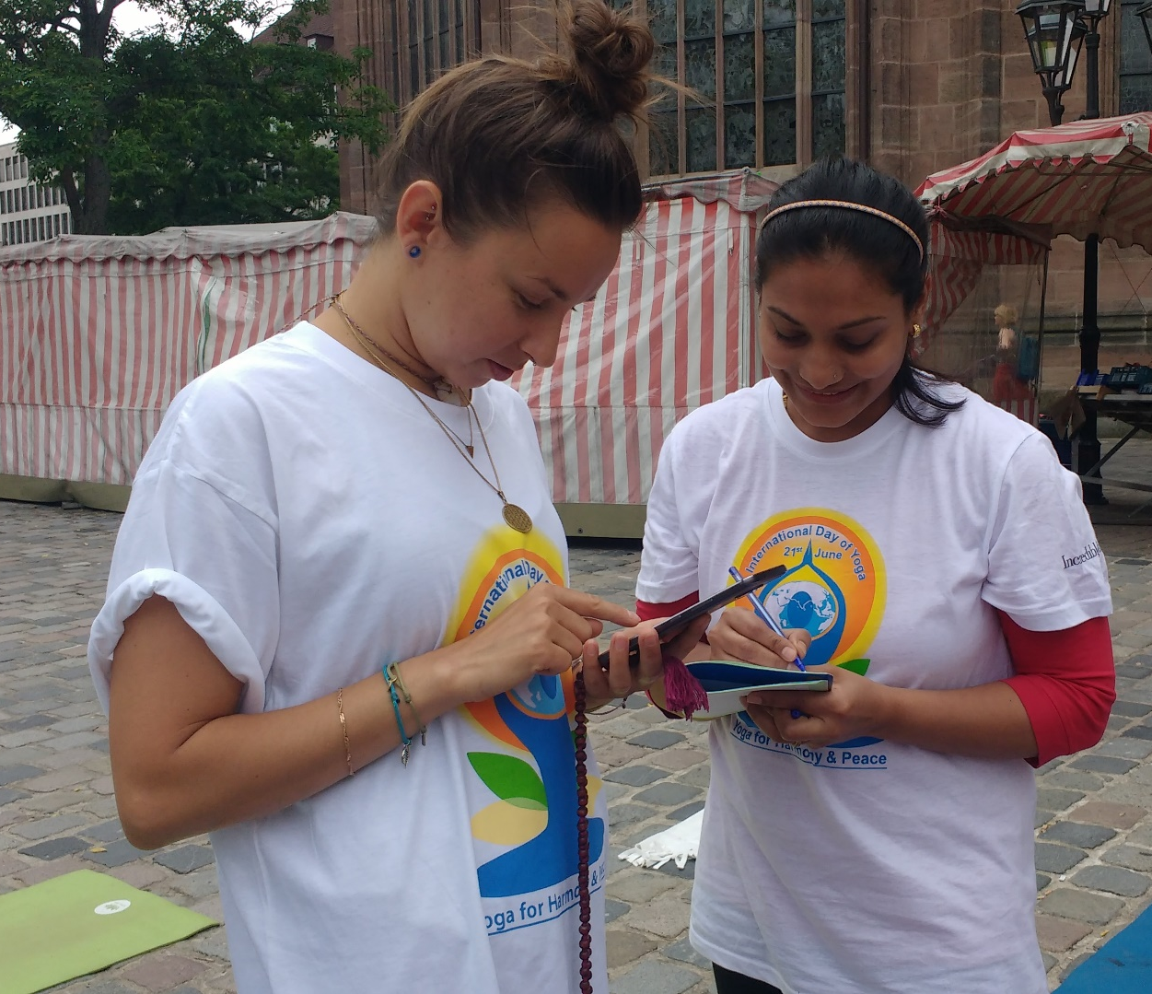
Usability Tests participant
Demographics
Name: Eva Age range : 25 to 30 Occupation: Web developer
Tasks
Overall, Eva navigated through the app very easily and said that it was very straight forward and made a few comments. As she is web developer by profession, she provided the detail feedback on each and every page.
While searching a yoga guru, she said that a voice search would be useful. She would like to have suggestions while typing a in search, just like on Google so the users can be directed.
On the experts’ profile, she feels the need to be reassured that the experts are actually verified from app side with an icon for instance and if they are currently online.
Observations
She found the app useful, very straight forward and liked the general simplicity of use. She didn’t hesitate when clicking on the button and knew what she had to do.

Slide 5
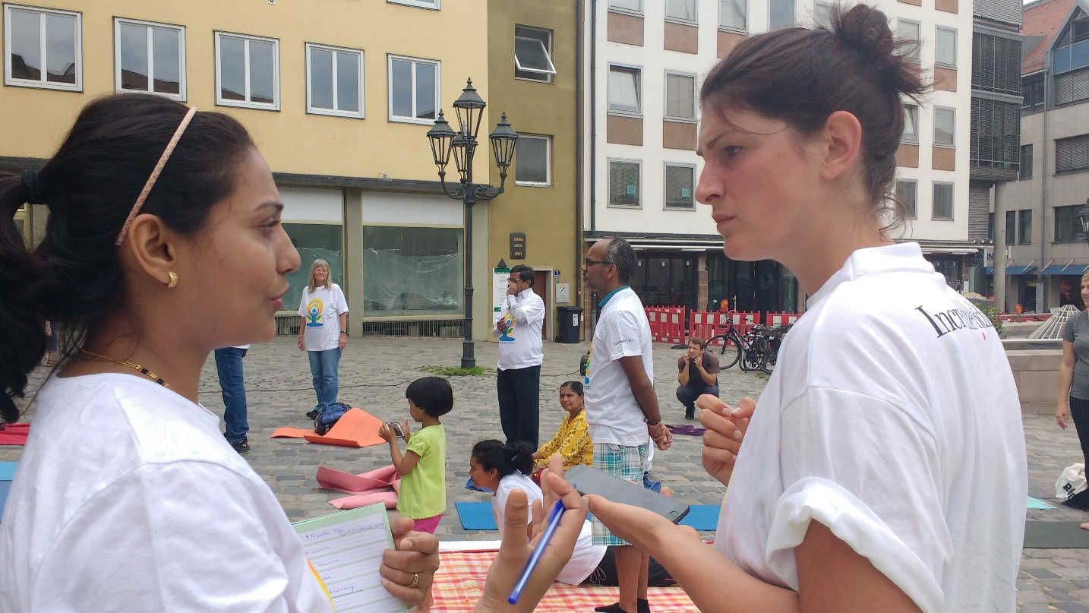
Usability Tests participant
Demographics
Name: Mimi Krakra Age range : 30 to 35 Occupation: Yoga teacher
Tasks
She found this app is very useful to reach out to the yoga users and find the clients for her yoga studio as she is yoga teacher by profession.
For her the experts’ profile was easy to find. She would have liked to see the number of reviews and rating.
She is more queries about booking packages and how it will going to works the payment process in actual app.
She suggest me the booking conformation by email is needed for reference purpose.
Observations
Mimi enjoyed using the app and liked the idea of having an app that helps users, especially with prenatal yoga and postnatal yoga. She also said many times that the app was already very nice and fun to use. She like to check out what happens when login as yoga guru.

Slide 6
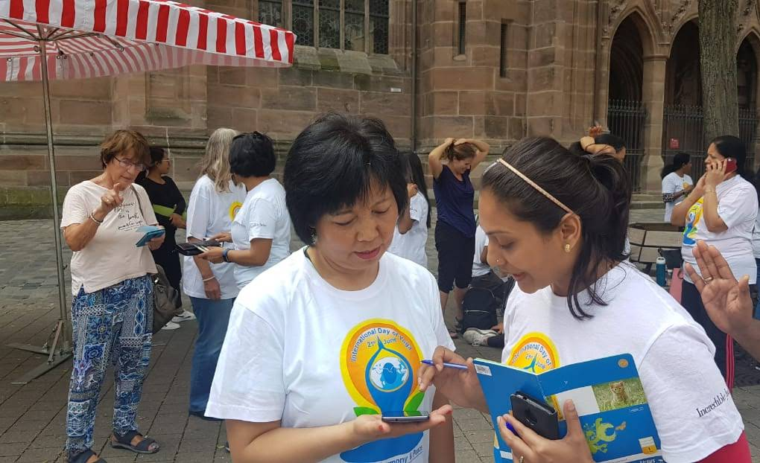
Usability Tests participant
Demographics
Name: Tina Age range : 35 to 40 Occupation: Business women
Tasks
She found Yogic app has unique idea and new concept of learning yoga from world famous yoga expert. She did not know, what to do and how to start with the first task after some guidance, she found this easy to use.
The functionality is good and things are clearly arranged design. She said this type of app is very new idea.
She did not suggest any changes or comment on features, But she ask me how booking will works and if I want to cancel the booking what will be the option to get the money refund.
Observations
Tina struggled to opened up app but for sure she want to use this app in future to learn the yoga from very famous yoga expert.

Slide 7
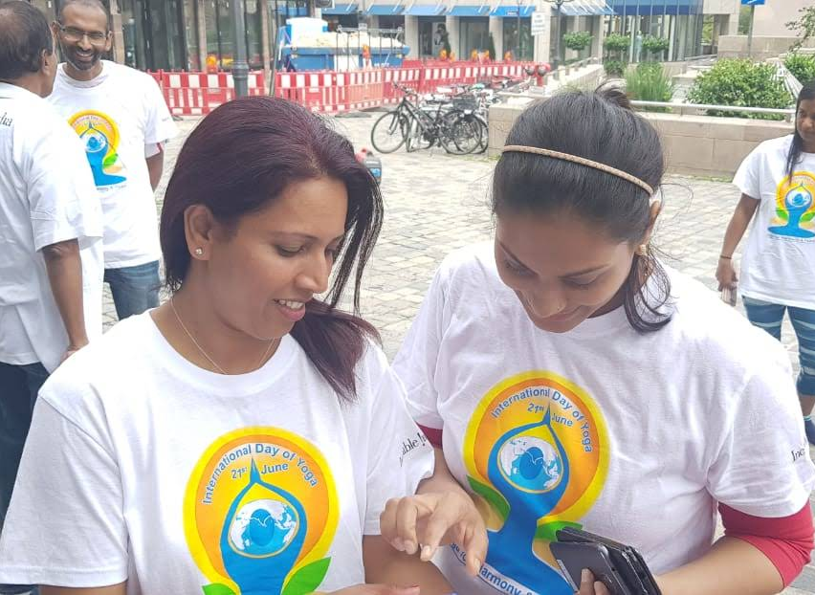
Usability Tests participant
Demographics
Name: Dr. Viji Aanad Age range : 35 to 40 Occupation: Chemistry professor and mother of 2 kids
Tasks
She is mother and more interested in the search of postnatal yoga expert. She found it very straight forward, quick and easy to find the desired type of yoga guru.
She liked the way the Video calling option was built: very standard and easy to use. She compared it with other yoga apps she used in the past.
She said “I like the fact that I can check the different yoga experts specialized in a specific yoga category at one place without going anywhere”
She suggest me, added into the favorite list is required before booking the yoga expert, so that it will be easy to compare the yoga guru before payment and actual booking.
Observations
For Dr. Viji, it was easy for her to navigate through the app. She specially liked the Video calling feature and layout as it was very simple and standard.

Slide 8
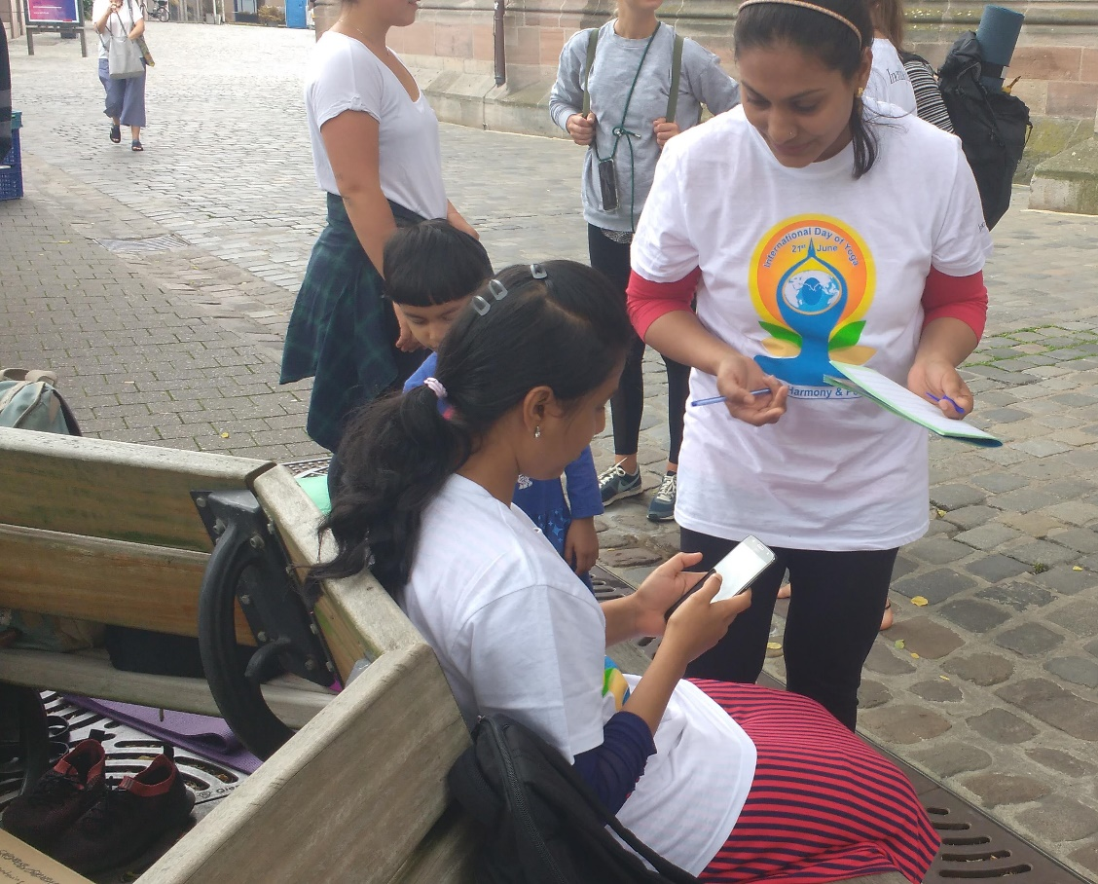
Usability Tests participant
Demographics
Name: Savita Age range : 20 to 25 Occupation: Student
Tasks
Savita was very shy girl. She was bit intimidated by new environment. But she was very confident for using app. After starting to play with app she start to talk more.
She like the concept and design layouts. She completed all the tasks without any assistance. It seems that she know all the steps in advance.
All the primary features which you need, are easily visible.
Observations
Overall, she like the idea and complete the navigation without any help.

Slide 9
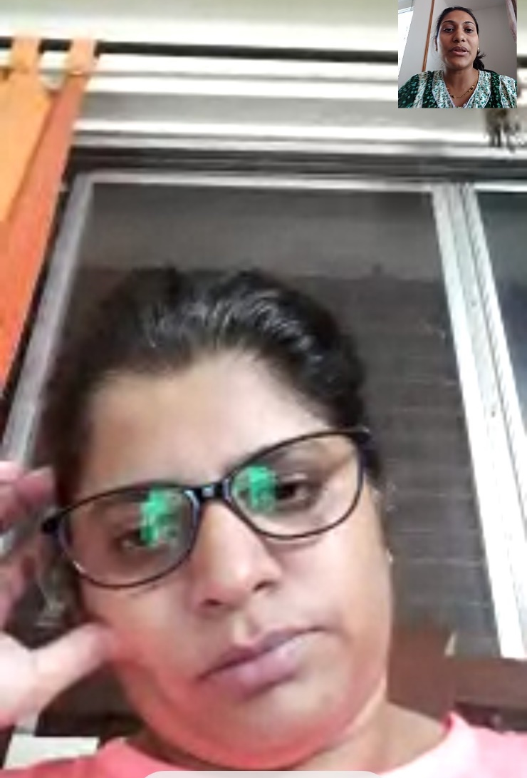
Usability Tests participant
Demographics
Name: Anita Age range : 35 to 40 Occupation: Banker
Tasks
She completed all the task. Appreciated reviews and rating liked them.
Initially she was avoiding to click on Payment button, while she think that it is actually going to pay and book the prenatal yoga expert.
After some guidance, she performed this task and forward to see the video call and reviewing expert features.
She comment and suggest that the Email confirmation is required before the actual call with the details such as date and time.
Observations
Initially, Anita was not so confidant about the booking process and payment methods. But she like the reviewing process for the yoga expert, and said that this is very fare and transparent way between yoga users and yoga guru.

Slide 10
Usability Test Conclusion
Overall, the test went really well and was really productive for me. The participants were very expressive with their feelings which was really helpful.
What I’ve learnt:
Yoga expert verifications is required
Search with suggestions is suggested
The booking conformation by email is needed
If the booking will cancel the money refund process is require
For comparison purpose shortlisted list of yoga experts are required before actual booking

